Slide 1


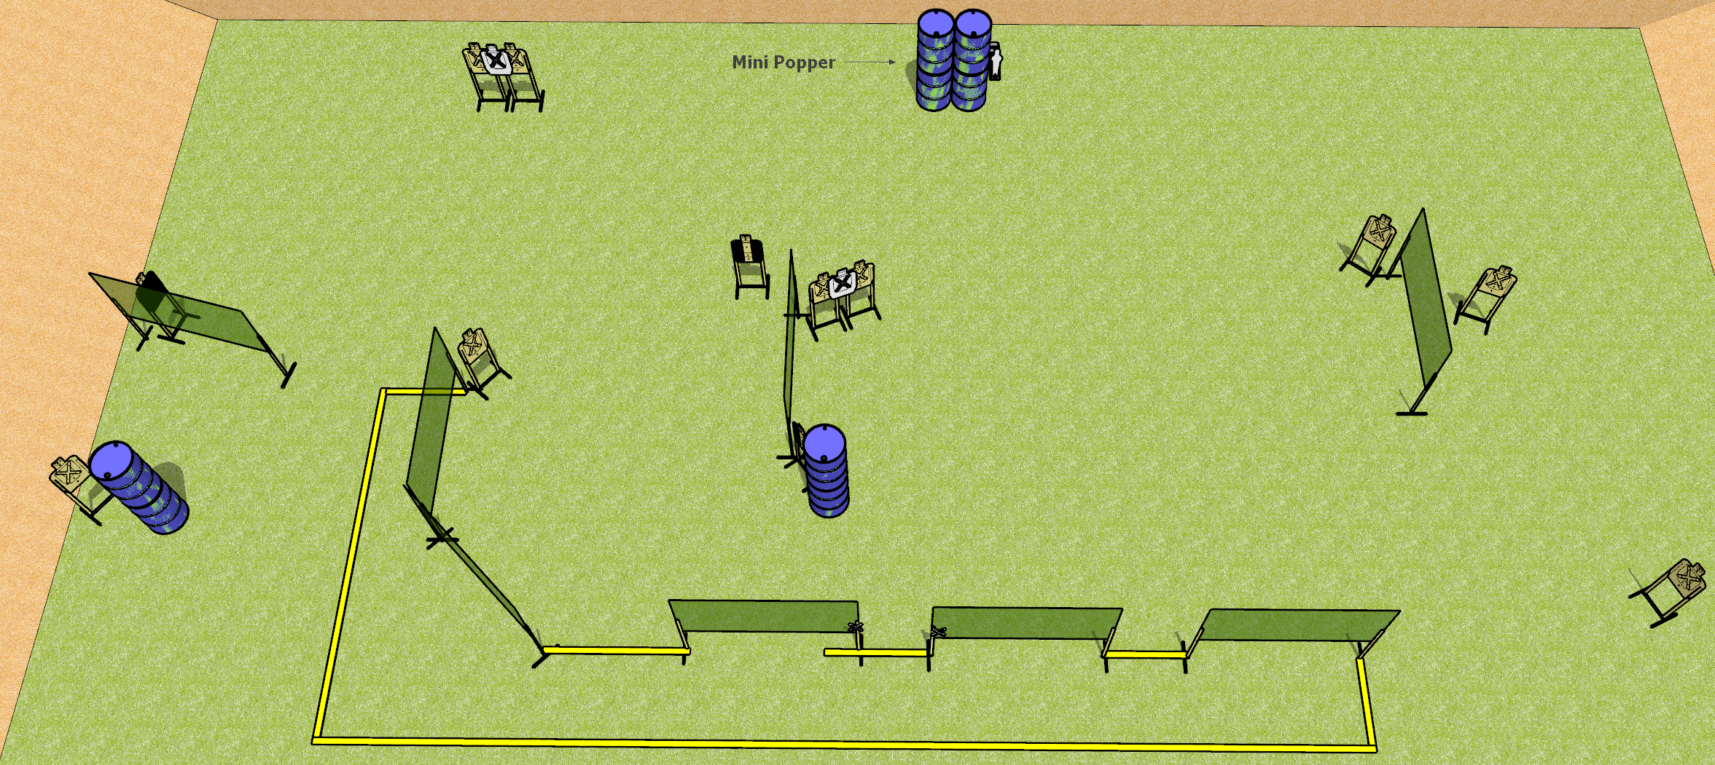
 | Dothan Gun Club – USPSA Match And I Said Hey Course Designer : Drew Coleman
START POSITION : Standing with both hands touching marks
GUN READY CONDITION : Pistol loaded and holstered. PCC loaded, shouldered, safety on, muzzle touching a mark. |  | SCORING: Comstock, 26 rounds TARGETS: 12 paper, 2 Steel SCORED HITS: Best 2 on paper, steel until down START-STOP: Audible, last shot RULES:
STAGE PROCEDURE: Engage targets as they become available from within the fault lines.

Slide 2
And I Said Hey
Written Stage Briefing
And I Said Hey is a 26 round, 130 point, Comstock Field Course. There are twelve USPSA targets and two mini poppers. The best two hits on paper will score. Steel must fall to score. The start signal is audible.
Handgun start position is standing with both hands touching marks. Pistol is loaded and holstered.
PCC start position is standing with loaded carbine held with both hands, safety on, muzzle touching either mark.
Upon start signal, engage targets as they become available from the shooting area.

